Slide 1
ORM "LINQ to DB"
используем возможности Postgres по максимуму

Slide 2
ORM "LINQ to DB"
используем возможности Postgres по максимуму
Обо мне
Сфера деятельности
Фадеев Алексей Сергеевич
Backend-разработка
Старший разработчик .NET
Работа с СУБД, оптимизация
Компания sibedge, г.Томск
Используем: PostgreSQL,
Microsoft SQL Server

Slide 3
Проблемы ORM
Встречаются плохие запросы для простых операций
Ограниченность (многое не поддерживается)

Slide 4
SELECT
[UnionAll1].[Id] AS [C1],
[UnionAll1].[Id1] AS [C2],
[UnionAll1].[Id2] AS [C3],
[UnionAll1].[Id3] AS [C4],
[UnionAll1].[Id4] AS [C5],
[UnionAll1].[Id5] AS [C6],
[UnionAll1].[Id6] AS [C7],
[UnionAll1].[Code1] AS [C8],
[UnionAll1].[VariantId] AS [C9],
[UnionAll1].[Description1] AS [C10],
[UnionAll1].[Name] AS [C11],
[UnionAll1].[BoxQuantity] AS [C12],
[UnionAll1].[C1] AS [C13],
[UnionAll1].[Id7] AS [C14],
[UnionAll1].[ProductId] AS [C15],
[UnionAll1].[VariantId1] AS [C16],
[UnionAll1].[CutCodeAnnotation] AS [C17],
[UnionAll1].[Description2] AS [C18],
[UnionAll1].[IsActive] AS [C19],
[UnionAll1].[CreatedDate] AS [C20],
[UnionAll1].[NutritionServingSize] AS [C21],
[UnionAll1].[NutritionServingContainer] AS [C22],
[UnionAll1].[NutritionCalories] AS [C23],
[UnionAll1].[NutritionTotalFit] AS [C24],
[UnionAll1].[NutritionSatFat] AS [C25],
[UnionAll1].[NutritionTransFat] AS [C26],
[UnionAll1].[NutritionCholesterol] AS [C27],
[UnionAll1].[NutritionSodium] AS [C28],
[UnionAll1].[NutritionCarbs] AS [C29],
[UnionAll1].[NutritionFiber] AS [C30],
[UnionAll1].[NutritionSugar] AS [C31],
[UnionAll1].[NutritionAddedSugar] AS [C32],
[UnionAll1].[NutritionProtein] AS [C33],
[UnionAll1].[NutritionVitD] AS [C34],
[UnionAll1].[NutritionCalcium] AS [C35],
[UnionAll1].[NutritionIron] AS [C36],
[UnionAll1].[NutritionPotassium] AS [C37],
[UnionAll1].[NutritionOverride] AS [C38],
[UnionAll1].[C2] AS [C39],
[UnionAll1].[C3] AS [C40],
[UnionAll1].[C4] AS [C41],
[UnionAll1].[C5] AS [C42],
[UnionAll1].[C6] AS [C43],
[UnionAll1].[C7] AS [C44],
[UnionAll1].[C8] AS [C45],
[UnionAll1].[C9] AS [C46],
[UnionAll1].[C10] AS [C47],
[UnionAll1].[C11] AS [C48],
[UnionAll1].[C12] AS [C49],
[UnionAll1].[C13] AS [C50],
[UnionAll1].[C14] AS [C51],
[UnionAll1].[C15] AS [C52],
[UnionAll1].[C16] AS [C53],
[UnionAll1].[C17] AS [C54],
[UnionAll1].[C18] AS [C55],
[UnionAll1].[C19] AS [C56],
[UnionAll1].[C20] AS [C57],
[UnionAll1].[C21] AS [C58],
[UnionAll1].[C22] AS [C59],
[UnionAll1].[C23] AS [C60],
[UnionAll1].[C24] AS [C61],
[UnionAll1].[C25] AS [C62],
[UnionAll1].[C26] AS [C63],
[UnionAll1].[C27] AS [C64],
[UnionAll1].[C28] AS [C65]
FROM (SELECT
CASE WHEN ([Extent4].[Id] IS NULL) THEN
CAST(NULL AS int) ELSE 1 END AS [C1],
[Limit1].[SortOrder] AS [SortOrder],
[Limit1].[Description] AS [Description],
[Limit1].[Code] AS [Code],
[Limit1].[Id1] AS [Id],
[Limit1].[Id1] AS [Id1],
[Limit1].[Id2] AS [Id2],
[Limit1].[Id1] AS [Id3],
[Limit1].[Id2] AS [Id4],
[Limit1].[Id] AS [Id5],
[Limit1].[Id] AS [Id6],
[Limit1].[Code] AS [Code1],
[Limit1].[VariantId] AS [VariantId],
[Limit1].[Description] AS [Description1],
[Limit1].[Name] AS [Name],
[Limit1].[BoxQuantity] AS [BoxQuantity],
[Extent4].[Id] AS [Id7],
[Extent4].[ProductId] AS [ProductId],
[Extent4].[VariantId] AS [VariantId1],
[Extent4].[CutCodeAnnotation] AS [CutCodeAnnotation],
[Extent4].[Description] AS [Description2],
[Extent4].[IsActive] AS [IsActive],
[Extent4].[CreatedDate] AS [CreatedDate],
[Extent4].[NutritionServingSize] AS [NutritionServingSize],
[Extent4].[NutritionServingContainer]
AS [NutritionServingContainer],
[Extent4].[NutritionCalories] AS [NutritionCalories],
[Extent4].[NutritionTotalFit] AS [NutritionTotalFit],
[Extent4].[NutritionSatFat] AS [NutritionSatFat],
[Extent4].[NutritionTransFat] AS [NutritionTransFat],
[Extent4].[NutritionCholesterol] AS [NutritionCholesterol],
[Extent4].[NutritionSodium] AS [NutritionSodium],
[Extent4].[NutritionCarbs] AS [NutritionCarbs],
[Extent4].[NutritionFiber] AS [NutritionFiber],
[Extent4].[NutritionSugar] AS [NutritionSugar],
[Extent4].[NutritionAddedSugar] AS [NutritionAddedSugar],
[Extent4].[NutritionProtein] AS [NutritionProtein],
[Extent4].[NutritionVitD] AS [NutritionVitD],
[Extent4].[NutritionCalcium] AS [NutritionCalcium],
[Extent4].[NutritionIron] AS [NutritionIron],
[Extent4].[NutritionPotassium] AS [NutritionPotassium],
[Extent4].[NutritionOverride] AS [NutritionOverride],
CAST(NULL AS int) AS [C2],
CAST(NULL AS int) AS [C3],
CAST(NULL AS int) AS [C4],
CAST(NULL AS int) AS [C5],
CAST(NULL AS int) AS [C6],
CAST(NULL AS int) AS [C7],
CAST(NULL AS varchar(1)) AS [C8],
CAST(NULL AS varchar(1)) AS [C9],
CAST(NULL AS int) AS [C10],
CAST(NULL AS int) AS [C11],
CAST(NULL AS int) AS [C12],
CAST(NULL AS int) AS [C13],
CAST(NULL AS varchar(1)) AS [C14],
CAST(NULL AS int) AS [C15],
CAST(NULL AS decimal(8,3)) AS [C16],
CAST(NULL AS int) AS [C17],
CAST(NULL AS int) AS [C18],
CAST(NULL AS decimal(5,2)) AS [C19],
CAST(NULL AS int) AS [C20],
CAST(NULL AS int) AS [C21],
CAST(NULL AS decimal(5,2)) AS [C22],
CAST(NULL AS int) AS [C23],
CAST(NULL AS int) AS [C24],
CAST(NULL AS decimal(6,2)) AS [C25],
CAST(NULL AS decimal(19,4)) AS [C26],
CAST(NULL AS varchar(1)) AS [C27],
CAST(NULL AS datetime2) AS [C28]
FROM (SELECT [Project1].[Id] AS [Id], [Project1].[VariantId] AS [VariantId],
[Project1].[BoxQuantity] AS [BoxQuantity], [Project1].[Id1] AS [Id1],
[Project1].[Code] AS [Code], [Project1].[Description] AS [Description],
[Project1].[Id2] AS [Id2], [Project1].[Name] AS [Name],
[Project1].[SortOrder] AS [SortOrder]
FROM ( SELECT
[Extent1].[Id] AS [Id],
[Extent1].[VariantId] AS [VariantId],
[Extent1].[BoxQuantity] AS [BoxQuantity],
[Extent2].[Id] AS [Id1],
[Extent2].[Code] AS [Code],
[Extent2].[Description] AS [Description],
[Extent3].[Id] AS [Id2],
[Extent3].[Name] AS [Name],
[Extent3].[SortOrder] AS [SortOrder]
FROM [dbo].[OrderDetailFab] AS [Extent1]
INNER JOIN [dbo].[Product] AS [Extent2] ON [Extent1].[ProductId]
= [Extent2].[Id]
INNER JOIN [dbo].[PrimalCut] AS [Extent3] ON [Extent2].[PrimalCutId]
= [Extent3].[Id]
WHERE ([Extent1].[OrderId] = @p__linq__0) AND ((@p__linq__1 IS NULL)
OR ([Extent2].[PrimalCutId] = @p__linq__2) OR (1 = 0))
) AS [Project1]
ORDER BY row_number() OVER (ORDER BY [Project1].[SortOrder] ASC,
[Project1].[Description] ASC, [Project1].[Code] ASC)
OFFSET 0 ROWS FETCH NEXT 100 ROWS ONLY ) AS [Limit1]
LEFT OUTER JOIN [dbo].[ProductVariant] AS [Extent4] ON [Limit1].[Id1]
= [Extent4].[ProductId]
UNION ALL
SELECT
2 AS [C1],
[Limit2].[SortOrder] AS [SortOrder],
[Limit2].[Description] AS [Description],
[Limit2].[Code] AS [Code],
[Limit2].[Id1] AS [Id],
[Limit2].[Id1] AS [Id1],
[Limit2].[Id2] AS [Id2],
[Limit2].[Id1] AS [Id3],
[Limit2].[Id2] AS [Id4],
[Limit2].[Id] AS [Id5],
[Limit2].[Id] AS [Id6],
[Limit2].[Code] AS [Code1],
[Limit2].[VariantId] AS [VariantId],
[Limit2].[Description] AS [Description1],
[Limit2].[Name] AS [Name],
[Limit2].[BoxQuantity] AS [BoxQuantity],
CAST(NULL AS int) AS [C2],
CAST(NULL AS int) AS [C3],
CAST(NULL AS int) AS [C4],
CAST(NULL AS int) AS [C5],
CAST(NULL AS varchar(1)) AS [C6],
CAST(NULL AS bit) AS [C7],
CAST(NULL AS datetime2) AS [C8],
CAST(NULL AS varchar(1)) AS [C9],
CAST(NULL AS varchar(1)) AS [C10],
CAST(NULL AS decimal(19,5)) AS [C11],
CAST(NULL AS decimal(19,5)) AS [C12],
CAST(NULL AS decimal(4,1)) AS [C13],
CAST(NULL AS decimal(4,1)) AS [C14],
CAST(NULL AS decimal(19,5)) AS [C15],
CAST(NULL AS decimal(19,5)) AS [C16],
CAST(NULL AS decimal(19,5)) AS [C17],
CAST(NULL AS decimal(19,5)) AS [C18],
CAST(NULL AS decimal(19,5)) AS [C19],
CAST(NULL AS decimal(19,5)) AS [C20],
CAST(NULL AS decimal(19,5)) AS [C21],
CAST(NULL AS decimal(19,5)) AS [C22],
CAST(NULL AS decimal(19,5)) AS [C23],
CAST(NULL AS decimal(19,5)) AS [C24],
CAST(NULL AS decimal(19,5)) AS [C25],
CAST(NULL AS bit) AS [C26],
[Extent8].[Id] AS [Id7],
[Extent8].[BusinessUnitId] AS [BusinessUnitId],
[Extent8].[DetailId] AS [DetailId],
[Extent8].[OrderId] AS [OrderId],
[Extent8].[ProductId] AS [ProductId],
[Extent8].[VariantId] AS [VariantId1],
[Extent8].[DjProductCode] AS [DjProductCode],
[Extent8].[CustomerProductCode] AS [CustomerProductCode],
[Extent8].[AnimalCategoryId] AS [AnimalCategoryId],
[Extent8].[AnimalGradeId] AS [AnimalGradeId],
[Extent8].[AnimalSubGradeId] AS [AnimalSubGradeId],
[Extent8].[EndReceiverId] AS [EndReceiverId],
[Extent8].[AnimalNumber] AS [AnimalNumber],
[Extent8].[AnimalSideId] AS [AnimalSideId],
[Extent8].[ScaleWeight] AS [ScaleWeight],
[Extent8].[ScaleQuantity] AS [ScaleQuantity],
[Extent8].[BagSizeId] AS [BagSizeId],
[Extent8].[BagTareWeight] AS [BagTareWeight],
[Extent8].[PiecesPerBag] AS [PiecesPerBag],
[Extent8].[BoxSizeId] AS [BoxSizeId],
[Extent8].[BoxTareWeight] AS [BoxTareWeight],
[Extent8].[BagsPerBox] AS [BagsPerBox],
[Extent8].[BagsPerPartialBox] AS [BagsPerPartialBox],
[Extent8].[TotalTareWeight] AS [TotalTareWeight],
[Extent8].[PricePerPound] AS [PricePerPound],
[Extent8].[SourceMachineName] AS [SourceMachineName],
[Extent8].[CreatedDate] AS [CreatedDate]
FROM (SELECT [Project3].[Id] AS [Id], [Project3].[VariantId] AS [VariantId],
[Project3].[BoxQuantity] AS [BoxQuantity], [Project3].[Id1] AS [Id1],
[Project3].[Code] AS [Code], [Project3].[Description] AS [Description],
[Project3].[Id2] AS [Id2], [Project3].[Name] AS [Name], [Project3].[SortOrder] AS [SortOrder]
FROM ( SELECT
[Extent5].[Id] AS [Id],
[Extent5].[VariantId] AS [VariantId],
[Extent5].[BoxQuantity] AS [BoxQuantity],
[Extent6].[Id] AS [Id1],
[Extent6].[Code] AS [Code],
[Extent6].[Description] AS [Description],
[Extent7].[Id] AS [Id2],
[Extent7].[Name] AS [Name],
[Extent7].[SortOrder] AS [SortOrder]
FROM [dbo].[OrderDetailFab] AS [Extent5]
INNER JOIN [dbo].[Product] AS [Extent6] ON [Extent5].[ProductId] = [Extent6].[Id]
INNER JOIN [dbo].[PrimalCut] AS [Extent7] ON [Extent6].[PrimalCutId] = [Extent7].[Id]
WHERE ([Extent5].[OrderId] = @p__linq__0) AND ((@p__linq__1 IS NULL)
OR ([Extent6].[PrimalCutId] = @p__linq__2) OR (1 = 0))
) AS [Project3]
ORDER BY row_number() OVER (ORDER BY [Project3].[SortOrder] ASC,
[Project3].[Description] ASC, [Project3].[Code] ASC)
OFFSET 0 ROWS FETCH NEXT 100 ROWS ONLY ) AS [Limit2]
INNER JOIN [dbo].[ProcessingLog] AS [Extent8] ON (2 = [Extent8].[BusinessUnitId])
AND ([Limit2].[Id] = [Extent8].[DetailId])) AS [UnionAll1]
ORDER BY [UnionAll1].[SortOrder] ASC, [UnionAll1].[Description] ASC, [UnionAll1].[Code] ASC,
[UnionAll1].[Id] ASC, [UnionAll1].[Id1] ASC, [UnionAll1].[Id2] ASC, [UnionAll1].[Id3] ASC,
[UnionAll1].[Id4] ASC, [UnionAll1].[Id6] ASC, [UnionAll1].[C1] ASC
4 года назад
SELECT
[Project1].[Id] AS [Id],
[Project1].[OrderId] AS [OrderId],
[Project1].[Code] AS [Code],
[Project1].[Description] AS [Description],
[Project1].[Name] AS [Name],
[Project1].[SortOrder] AS [SortOrder],
[Project1].[C1] AS [C1],
[Project1].[C2] AS [C2],
[Project1].[BoxQuantity] AS [BoxQuantity]
FROM ( SELECT
[Extent1].[Id] AS [Id],
[Extent1].[OrderId] AS [OrderId],
[Extent1].[BoxQuantity] AS [BoxQuantity],
[Extent4].[Code] AS [Code],
[Extent4].[Description] AS [Description],
[Extent5].[Name] AS [Name],
[Extent5].[SortOrder] AS [SortOrder],
CASE WHEN ([Extent3].[Id] IS NULL) THEN 0 ELSE [Extent3].[CutCodeAnnotation] END AS [C1],
CASE WHEN ([GroupBy1].[K1] IS NULL) THEN 0 ELSE [GroupBy1].[A1] END AS [C2]
FROM [dbo].[OrderDetailFab] AS [Extent1]
LEFT OUTER JOIN (SELECT
[Extent2].[DetailId] AS [K1],
SUM([Extent2].[ScaleQuantity]) AS [A1]
FROM [dbo].[ProcessingLog] AS [Extent2]
WHERE ([Extent2].[OrderId] = @p__linq__0) AND (2 = [Extent2].[BusinessUnitId])
GROUP BY [Extent2].[DetailId] ) AS [GroupBy1] ON [Extent1].[Id] = [GroupBy1].[K1]
LEFT OUTER JOIN [dbo].[ProductVariant] AS [Extent3] ON ([Extent1].[ProductId]
= [Extent3].[ProductId]) AND (([Extent1].[VariantId] = [Extent3].[VariantId])
OR (([Extent1].[VariantId] IS NULL) AND ([Extent3].[VariantId] IS NULL)))
INNER JOIN [dbo].[Product] AS [Extent4] ON [Extent1].[ProductId] = [Extent4].[Id]
INNER JOIN [dbo].[PrimalCut] AS [Extent5] ON [Extent4].[PrimalCutId] = [Extent5].[Id]
WHERE ([Extent1].[OrderId] = @p__linq__1) AND ((@p__linq__2 IS NULL) OR ([Extent4].[PrimalCutId] = @p__linq__3) OR (1 = 0))
) AS [Project1]
ORDER BY row_number() OVER (ORDER BY [Project1].[SortOrder] ASC, [Project1].[Description] ASC, [Project1].[Code] ASC)
OFFSET 0 ROWS FETCH NEXT 100 ROWS ONLY
https://pgconf.ru/2019/242760

Slide 5
Написание запросов
Главное правило:
Пишем на C#/LINQ, мыслим в SQL!
Проверять SQL на выходе
Больше практики!

Slide 6
Проблемы ORM
Встречаются плохие запросы для простых операций
Но опытные разработчики научились писать хорошие
Ограниченность (многое не поддерживается)

Slide 7
LINQ to DB
Альтернативная ORM для .NET
Богатый функционал «из коробки»
Возможность легко писать расширения
Высокая производительность

Slide 8
ORM становятся лучше
Например, в EF Core появилась поддержка поиска по элементу массива
var items = await context.Articles
.Where(x => x.KeyWords.Contains("postgres"))
.ToListAsync();
SELECT *
FROM "article" "x"
WHERE 'postgres' = ANY ("x"."key_words");

Slide 9
И всё же, ORM ограничены
Особенно при работе с Postgres…
…с массой конструкций, выходящих за рамки стандарта SQL

Slide 10
И всё же, ORM ограничены
Особенно при работе с Postgres…
…с массой конструкций, выходящих за рамки стандарта SQL
Нет поддержки индексов:
SELECT *
FROM "article" "x"
WHERE 'postgres' = ANY ("x"."key_words");
Есть поддержка индексов:
SELECT *
FROM "article" "x"
WHERE "x"."key_words" @> ARRAY ['postgres'];

Slide 11
LINQ to DB
Альтернативная ORM для .NET
Богатый функционал «из коробки»
Возможность легко писать расширения
Высокая производительность

Slide 12
Работа с массивами
ArrayAggregate<T>(ISqlExtension?, T, AggregateModifier)
ArrayAggregate<T>(ISqlExtension?, T)
ArrayAggregate<TEntity, TV>(IEnumerable<TEntity>, Func<TEntity, TV>, …)
ArrayAggregate<TEntity, TV>(IQueryable<TEntity>, Expression<Func<TEntity, TV>>)
ArrayAppend<T>(IPostgreSQLExtensions?, T[], T)
ArrayCat<T>(IPostgreSQLExtensions?, T[], T[])
ArrayDims<T>(IPostgreSQLExtensions?, T[])
ArrayLength<T>(IPostgreSQLExtensions?, T[], int)
ArrayLower<T>(IPostgreSQLExtensions?, T[], int)
ArrayNDims<T>(IPostgreSQLExtensions?, T[])
ArrayPosition<T>(IPostgreSQLExtensions?, T[], T, int)
ArrayPosition<T>(IPostgreSQLExtensions?, T[], T)
ArrayPositions<T>(IPostgreSQLExtensions?, T[], T)
ArrayPrepend<T>(IPostgreSQLExtensions?, T, T[])
ArrayRemove<T>(IPostgreSQLExtensions?, T[], T)
ArrayReplace<T>(IPostgreSQLExtensions?, T[], T, T)
ArrayToString<T>(IPostgreSQLExtensions?, T[], string, string)
ArrayToString<T>(IPostgreSQLExtensions?, T[], string)
ArrayUpper<T>(IPostgreSQLExtensions?, T[], int)
Cardinality<T>(IPostgreSQLExtensions?, T[])
ConcatArrays<T>(IPostgreSQLExtensions?, T[], T[][])
ConcatArrays<T>(IPostgreSQLExtensions?, T[][], T[])
ConcatArrays<T>(IPostgreSQLExtensions?, params T[][])
ContainedBy<T>(IPostgreSQLExtensions?, T[], T[])
Contains<T>(IPostgreSQLExtensions?, T[], T[])
GreaterThan<T>(IPostgreSQLExtensions?, T[], T[])
GreaterThanOrEqual<T>(IPostgreSQLExtensions?, T[], T[])
LessThan<T>(IPostgreSQLExtensions?, T[], T[])
LessThanOrEqual<T>(IPostgreSQLExtensions?, T[], T[])
Overlaps<T>(IPostgreSQLExtensions?, T[], T[])
StringToArray(IPostgreSQLExtensions?, string, string, string)
StringToArray(IPostgreSQLExtensions?, string, string)
ValueIsEqualToAny<T>(IPostgreSQLExtensions?, T, T[])
ValueIsGreaterThanAny<T>(IPostgreSQLExtensions?, T, T[])
ValueIsGreaterThanOrEqualToAny<T>(IPostgreSQLExtensions?, T, T[])
ValueIsLessThanAny<T>(IPostgreSQLExtensions?, T, T[])
ValueIsLessThanOrEqualToAny<T>(IPostgreSQLExtensions?, T, T[])
ValueIsNotEqualToAny<T>(IPostgreSQLExtensions?, T, T[])

Slide 13
Поиск в массиве с поддержкой индекса
var filter = new[] { 2, 5 };
var result = await context.Routes
.Where(x => Sql.Ext.PostgreSQL().Contains(x.DaysOfWeek, filter))
.ToListAsync();
SELECT
x.aircraft_code, x.arrival_airport, x.arrival_airport_name,
x.arrival_city, x.days_of_week, x.departure_airport,
x.departure_airport_name, x.departure_city, x.duration, x.flight_no
FROM
"public".routes x
WHERE
x.days_of_week @> :filter_1

Slide 14
Рекурсивные CTE
Для иерархических структур

Slide 15
Рекурсивные CTE
Пример задачи:
Задано несколько Id
Получить всех предков

Slide 16
Рекурсивные CTE
Пишем класс для CTE
private class FolderHierarchy
{
/// <summary> Заданный Id </summary>
public int StartId { get; set; }
/// <summary> Id текущей папки </summary>
public int CurrentId { get; set; }
/// <summary> Id родительской папки </summary>
public int? ParentId { get; set; }
/// <summary> Уровень иерархии </summary>
public int HierarchyLevel { get; set; }
}

Slide 17
Рекурсивные CTE
var hierarchyCte = context.GetCte<FolderHierarchy>(hierarchy =>
{
return
(
from f in context.Folders
where f.Id == 23 || f.Id == 11
select new FolderHierarchy
{
CurrentId = f.Id,
StartId = f.Id,
ParentId = f.ParentId,
HierarchyLevel = 1
}
)
.Concat
(
from f in context.Folders
join h in hierarchy on f.Id equals h.ParentId
select new FolderHierarchy
{
CurrentId = f.Id,
StartId = h.StartId,
ParentId = f.ParentId,
HierarchyLevel = h.HierarchyLevel + 1
}
);
});
Начало поиска
Задаём Id
Рекурсия
JOIN родителя

Slide 18
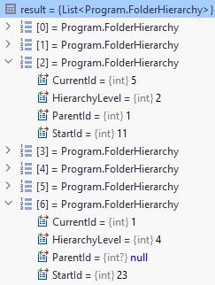
Рекурсивные CTE
WITH RECURSIVE hierarchy0
(
"StartId", "CurrentId", "HierarchyLevel", "ParentId"
)
AS
(
SELECT f.id, f.id, 1, f.parent_id
FROM test.folder f
WHERE (f.id = 23 OR f.id = 11)
UNION ALL
SELECT h."StartId", f_1.id, h."HierarchyLevel" + 1,
f_1.parent_id
FROM test.folder f_1
INNER JOIN hierarchy0 h ON f_1.id = h."ParentId"
)
SELECT * FROM hierarchy0 t1
ORDER BY t1."StartId", t1."HierarchyLevel"

Slide 19
Табличные функции
Пример сложного запроса:
Вызываем табличную функцию
JOIN результата с таблицей

Slide 20
Табличные функции
var result = await (from gs in context.GenerateSeries(5600, 5700)
join a in context.Items on gs equals a.Value
select a)
.ToListAsync();
SELECT *
FROM GENERATE_SERIES(:p_1, :p_2) gs
INNER JOIN items a ON gs.* = a.value

Slide 21
Табличные функции
Пример сложного запроса:
Делаем запрос к таблице
Поля результата подставляем в аргументы табличной функции

Slide 22
Табличные функции
var result = await (from a in context.Items
from gs in context.GenerateSeries(a.Value, a. Value + 10)
select gs)
.ToListAsync();
SELECT gs
FROM items a
INNER JOIN LATERAL
GENERATE_SERIES(a.value, a.value + 10) gs ON 1=1

Slide 23
И всё же, ORM ограничены
Особенно при работе с Postgres…
…с массой конструкций, выходящих за рамки стандарта SQL

Slide 24
LINQ to DB
Альтернативная ORM для .NET
Богатый функционал «из коробки»
Возможность легко писать расширения
Высокая производительность

Slide 25
Встроенный полнотекстовый поиск
SELECT 'a fat cat sat on a mat and ate a fat rat'::tsvector @@
'cat & rat'::tsquery;
Удобно делать tsvector вычисляемой колонкой

Slide 26
Встроенный полнотекстовый поиск
LinqToDb: пишем метод-расширение
[Sql.Expression("{0} @@ to_tsquery('russian', {1})", ServerSideOnly = true,
Precedence = Precedence.Comparison, IsPredicate = true)]
public static bool Matches(this NpgsqlTsVector v, string p) =>
throw new NotImplementedException();
var result = await context.Folders
.Where(x => x.FullTextData.Matches("лесные | дикие"))
.ToListAsync();

Slide 27
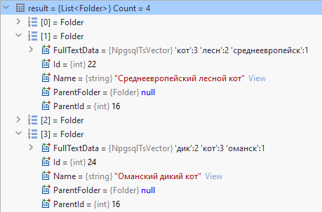
Встроенный полнотекстовый поиск
var result = await context.Folders
.Where(x => x.FullTextData.Matches("лесные | дикие"))
.ToListAsync();
SELECT *
FROM folder x
WHERE x.full_text_data @@
to_tsquery('russian', 'лесные | дикие')
Поддержка словарей Hunspell

Slide 28
Поиск в пространстве (KNN)
SELECT point(3, 0) <-> point (0, 4);
5

Slide 29
Поиск в пространстве (KNN)
SELECT * FROM building
ORDER BY coordinates <-> point (53.7, 87.7)
LIMIT 10;

Slide 30
Поиск в пространстве (KNN)
[Sql.Expression("{0} <-> {1}", ServerSideOnly = true)]
public static double Distance(NpgsqlPoint p1, NpgsqlPoint p2) =>
throw new NotImplementedException();
var myPoint = new NpgsqlPoint { X = 48, Y = 46 };
var result = await context.Airports
.Select(x => new
{
Data = x,
Distance = PgExt.Distance(myPoint, x.Coordinates)
})
.OrderBy(x => x.Distance)
.Take(10)
.ToListAsync();

Slide 31
Поиск в пространстве (KNN)
SELECT
x.airport_name, x.city, x.coordinates,
x.id, x.timezone, :myPoint <-> x.coordinates
FROM
airports x
ORDER BY
:myPoint <-> x.coordinates
LIMIT :take
PostGIS: правильные расстояния на земном шаре

Slide 32


Поиск в JSONB
Поиск по вхождению объекта
{
"en": "Moscow",
"ru": "Москва",
"fr": "Moscou"
}
{
"ru": "Москва"
}
@>
{
"en": "Moscow",
"ru": "Москва",
"fr": "Moscou"
}
{
"ru": "Томск"
}
@>

Slide 33
Поиск в JSONB
Вхождение (для поиска, поддерживаются индексы)
[Sql.Expression("{0} @> {1}::jsonb", ServerSideOnly = true,
Precedence = Precedence.Comparison, IsPredicate = true)]
public static bool JsonContains(this string j1, string j2) =>
throw new NotImplementedException();
Значение по ключу объекта
[Sql.Expression("{0}->>{1}", ServerSideOnly = true)]
public static string JsonChildText(this string json, string key) =>
throw new NotImplementedException();

Slide 34
Поиск в JSONB
var filter = new { en = "Tomsk" };
var filterJson = JsonSerializer.Serialize(filter);
var result = await context.AirportsDatas
.Where(x => x.City.JsonContains(filterJson))
.Select(x => new { x.AirportName, City = x.City.JsonChildText("en") })
.FirstOrDefaultAsync();
SELECT x.airport_name, x.city->>'en'
FROM airports_data x
WHERE x.city @> :filterJson::jsonb
LIMIT :take

Slide 35
Продвинутый поиск в JSONB
Расширение jsquery
SELECT * FROM js_test WHERE value @@
'%(NOT #(NOT ($ >= 0 AND $ <= 1)) AND $ IS ARRAY)'::jsquery;

Slide 36
Продвинутый поиск в JSONB
[Sql.Expression("{0} @@ {1}::jsquery", ServerSideOnly = true,
Precedence = Precedence.Comparison, IsPredicate = true)]
public static bool MatchesJsquery(this string data, string query) =>
throw new NotImplementedException();
var result = await context.Items
.Where(x => x.Data.MatchesJsquery("#:.%:($ >= 0 AND $ <= 1)"))
.ToListAsync();
SELECT * FROM items x
WHERE x.data @@ '#:.%:($ >= 0 AND $ <= 1)':jsquery

Slide 37
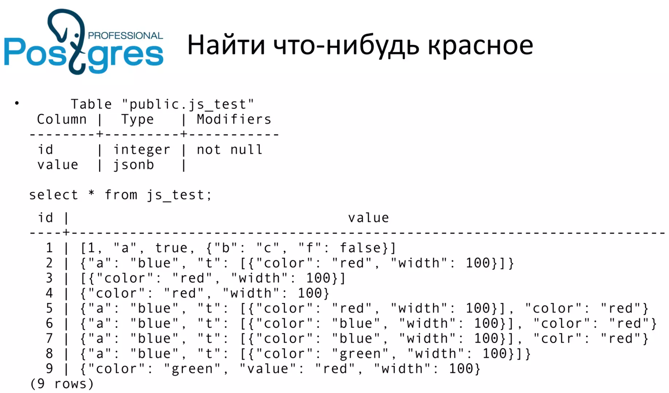
https://2015.codefest.ru/lecture/1000

Slide 38
SELECT * FROM js_test
WHERE value @@ '*.color="red"'::jsquery;

Slide 39
Продвинутый поиск в JSONB
[Sql.Expression("{0} @@ '*.{1}=\"{2}\"')::jsquery",
ServerSideOnly = true, Precedence = Precedence.Comparison, IsPredicate = true)]
public static bool JsonContainsAnywhere(this string j, string k, string v) =>
throw new NotImplementedException();

Slide 40
Продвинутый поиск в JSONB
[Sql.Expression("{0} @@ '*.{1}=\"{2}\"')::jsquery",
ServerSideOnly = true, Precedence = Precedence.Comparison, IsPredicate = true)]
public static bool JsonContainsAnywhere(this string j, string k, string v) =>
throw new NotImplementedException();
[Sql.Expression("{0} @@ ('*.' || {1} || '=\"' || {2} || '\"')::jsquery",
ServerSideOnly = true, Precedence = Precedence.Comparison, IsPredicate = true)]
public static bool JsonContainsAnywhere(this string j, string k, string v) =>
throw new NotImplementedException();

Slide 41
Продвинутый поиск в JSONB
Найти что-нибудь красное
var result = await context.Items
.Where(x => x.Data.JsonContainsAnywhere("color", "red"))
.ToListAsync();
SELECT * FROM items x
WHERE x.data @@
('*.' || 'color' || '="' || 'red' || '"')::jsquery

Slide 42
Продвинутый поиск в JSONB
Найти что-нибудь красное
var result = await context.Items
.Where(x => x.Data.JsonContainsAnywhere("color", "red"))
.ToListAsync();
Найти что-нибудь русское
var result = await context.Items
.Where(x => x.Data.JsonContainsAnywhere("lang", "ru"))
.ToListAsync();

Slide 43
COUNT DISTINCT
Пример задачи:
Авиаперелёты за период времени
Сгруппировать по аэропортам отправления
Посчитать число разных аэропортов прибытия

Slide 44
COUNT DISTINCT
SELECT t1.departure_airport,
COUNT(*),
COUNT(DISTINCT t1.arrival_airport)
FROM "public".flights_v t1
GROUP BY t1.departure_airport
var result = await context.FlightsVs
.GroupBy(x => x.DepartureAirport)
.Select(g => new
{
DepartureAirport = g.Key,
Count = g.Count(),
// ArrivalAirportCount = g.DistinctCount(x => x.ArrivalAirport)
ArrivalAirportCount = g.Select(x => x.ArrivalAirport).Distinct().Count()
})
.ToListAsync();

Slide 45
COUNT DISTINCT
[Sql.Expression("COUNT(DISTINCT {1})", ServerSideOnly = true, IsAggregate = true)]
public static long DistinctCount<TEntity, TK, TV>(this IGrouping<TK, TEntity> g,
Expression<Func<TEntity, TV>> expr) =>
throw new NotImplementedException();

Slide 46
COUNT DISTINCT
var result = await context.FlightsVs
.GroupBy(x => x.DepartureAirport)
.Select(g => new
{
DepartureAirport = g.Key,
Count = g.Count(),
ArrivalAirportCount = g.DistinctCount(x => x.ArrivalAirport)
})
.ToListAsync();
SELECT t1.departure_airport,
COUNT(*),
COUNT(DISTINCT t1.arrival_airport)
FROM "public".flights_v t1
GROUP BY t1.departure_airport

Slide 47
Агрегация в массив
Пример задачи:
Таблица аэропортов
Сгруппировать по часовым поясам
Для каждого получить массив координат

Slide 48
Агрегация в массив
[Sql.Expression("array_agg({1})", ServerSideOnly = true, IsAggregate = true)]
public static TV[] ArrayAgg<TEntity, TK, TV>(this IGrouping<TK, TEntity> g,
Expression<Func<TEntity, TV>> expr) =>
throw new NotImplementedException();

Slide 49
Агрегация в массив
var result = await context.Airports
.GroupBy(x => x.TimeZone)
.Select(g => new
{
TimeZone = g.Key,
Count = g.Count(),
Coord = g.ArrayAgg(x => x.Coordinates)
})
.ToListAsync();
SELECT t1.timezone, Count(*),
array_agg(t1.coordinates)
FROM airports t1
GROUP BY t1.timezone

Slide 50
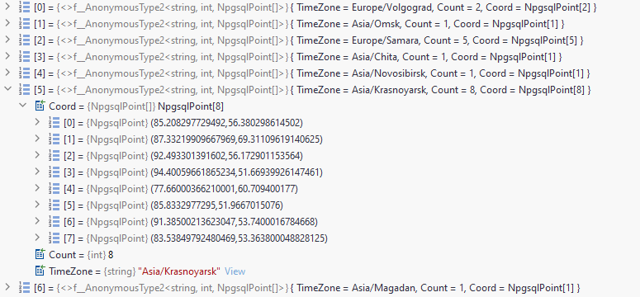
Агрегация в массив

Slide 51
Агрегация в JSON
Пример задачи:
Таблица аэропортов
Сгруппировать по часовым поясам
Для каждого получить объект вида:
{
"AER": "Сочи",
"DME": "Домодедово",
"GDZ": "Геленджик",
"KZN": "Казань",
"LED": "Пулково"
}

Slide 52
Агрегация в JSON
[Sql.Expression("jsonb_object_agg({1}, {2})", ServerSideOnly = true,
IsAggregate = true)]
public static string JsonObjAgg<TEntity, TK, TV>(this IGrouping<TK, TEntity> g,
Expression<Func<TEntity, string>> exprKey, Expression<Func<TEntity, TV>> exprVal) => throw new NotImplementedException();

Slide 53
Агрегация в JSON
var result = await context.AirportsDatas
.GroupBy(x => x.TimeZone)
.Select(g => new
{
TimeZone = g.Key,
Count = g.Count(),
Ids = g.JsonObjAgg(x => x.Id, x => x.AirportName.JsonChildText("ru"))
})
.ToListAsync();
SELECT t1.timezone, Count(*),
jsonb_object_agg(t1.id, t1.airport_name->>'ru')
FROM airports_data t1
GROUP BY t1.timezone

Slide 54
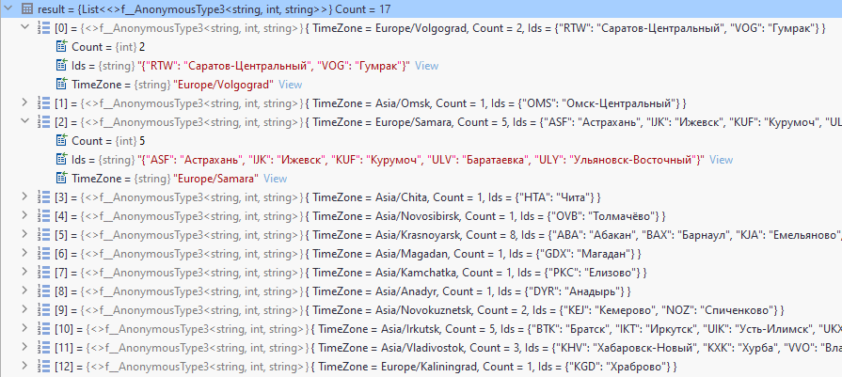
Агрегация в JSON

Slide 55
LINQ to DB
Альтернативная ORM для .NET
Богатый функционал «из коробки»
Возможность легко писать расширения
Высокая производительность

Slide 56
Получаем миллион
3 колонки
Сначала "прогреваем"
Отключаем логи

Slide 57
Получаем миллион
EF Core (AsNoTracking)
965.3
922.6
Dapper
1068.2
1097.9
LINQ to DB
x1.63 vs Dapper
650.7
676.5
x1.42 vs EF Core

Slide 58
Подведём итог
Самое главное: принцип простой расширяемости
Можно использовать весь арсенал СУБД
Даже специфические конструкции Postgres
И даже из сторонних расширений
Неограниченная гибкость

Slide 59
Проблемы ORM решаемы!
Встречаются плохие запросы для простых операций
Но опытные разработчики научились писать хорошие
Ограниченность (многое не поддерживается)
LINQ to DB решает проблему

Slide 60

КОНЕЦ

Slide 61
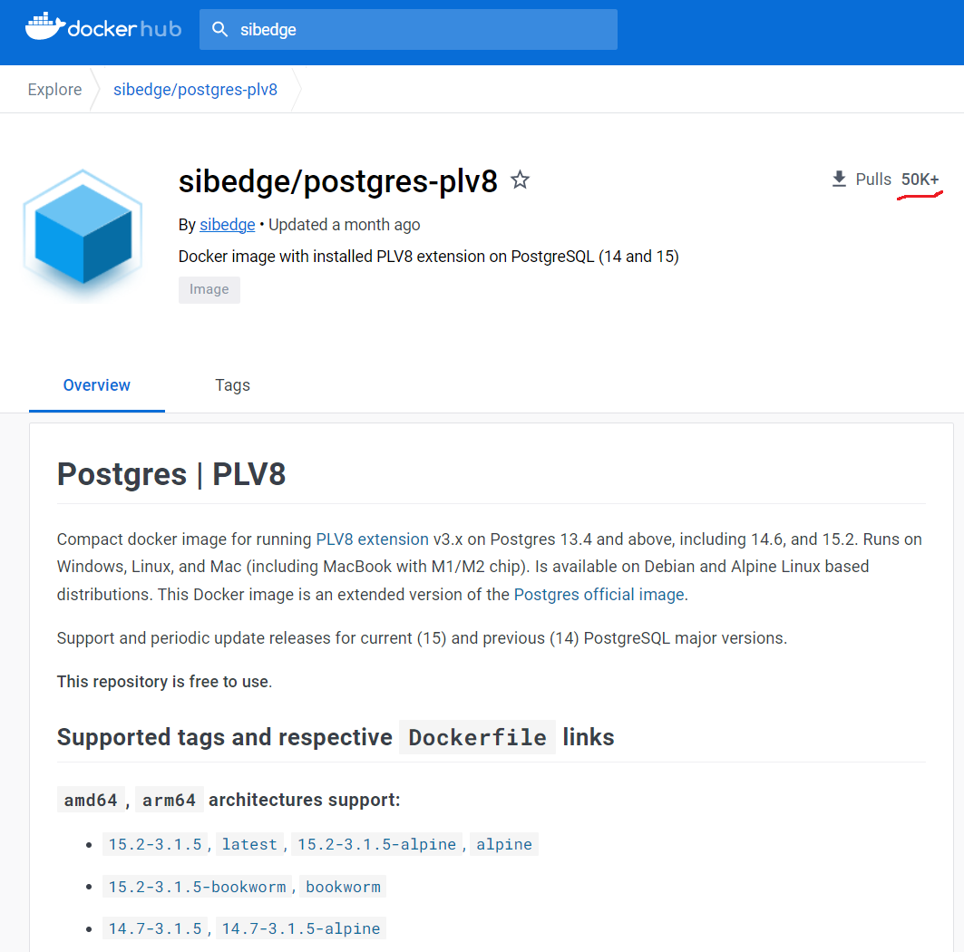

Slide 62
Ссылки
LINQ to DB
https://github.com/linq2db/linq2db
https://linq2db.github.io/api/LinqToDB.DataProvider.PostgreSQL.PostgreSQLExtensions.html
https://www.nuget.org/packages/linq2db
Документация PostgreSQL на русском
Демонстрационная база данных
https://postgrespro.ru/docs
https://postgrespro.ru/education/demodb
Мои контакты
fadeevas@sibedge.com
https://vk.com/fadeev

